Slide 1
Supersymmetric elements in positive characteristic
Maurice Auslander International Conference
April 28, 2018, Woods Hole
Frantisek Marko
Pennsylvania State University
Hazleton, USA

Slide 2
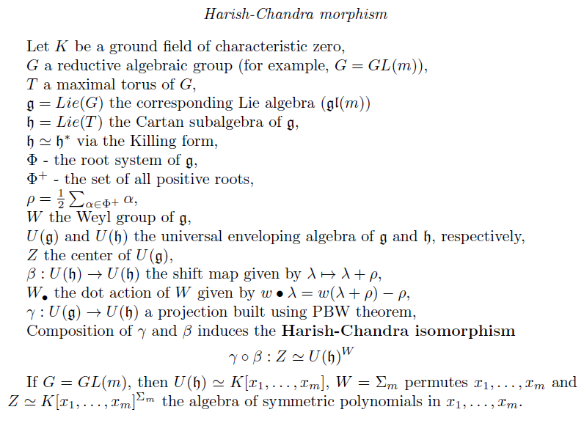

Slide 4
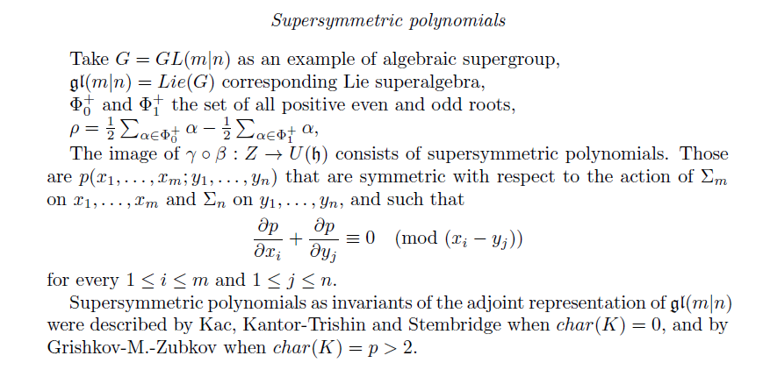

Slide 5
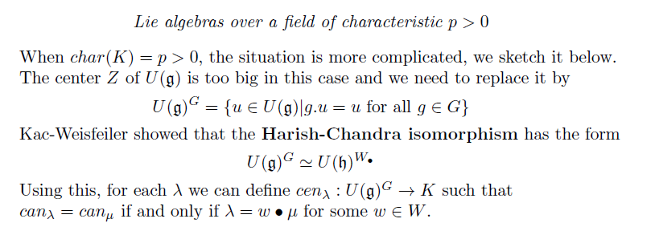

Slide 6
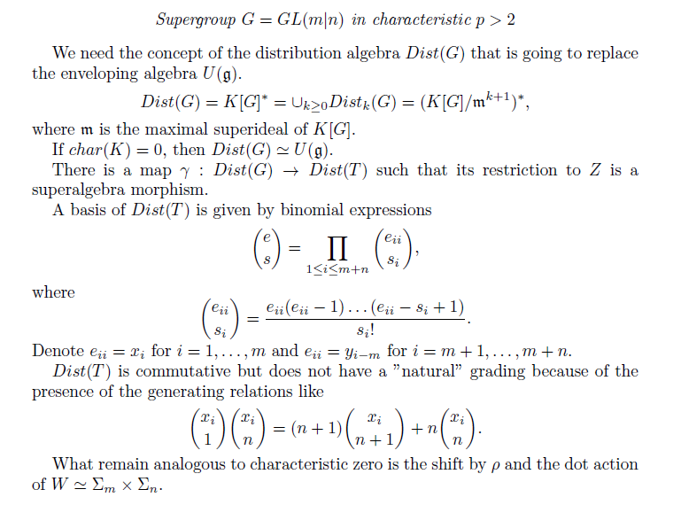

Slide 7
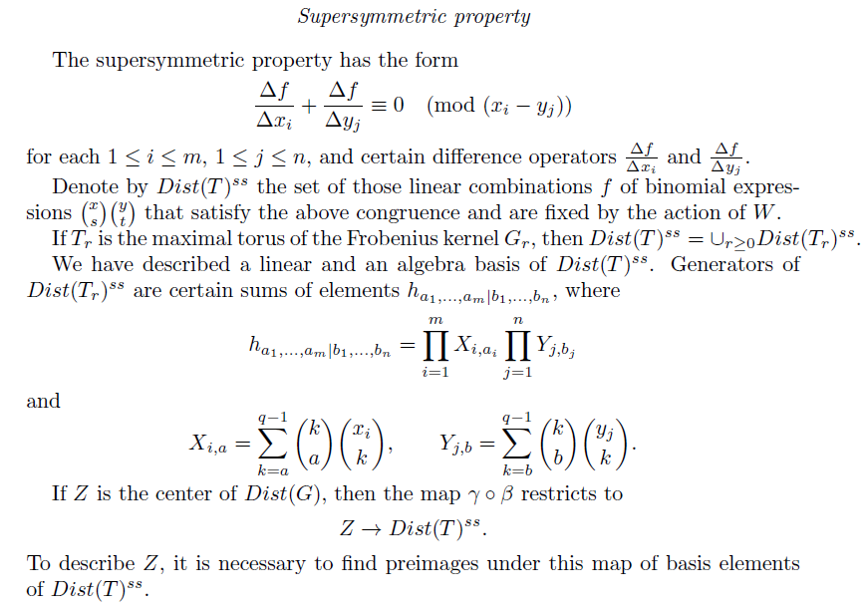

Slide 8
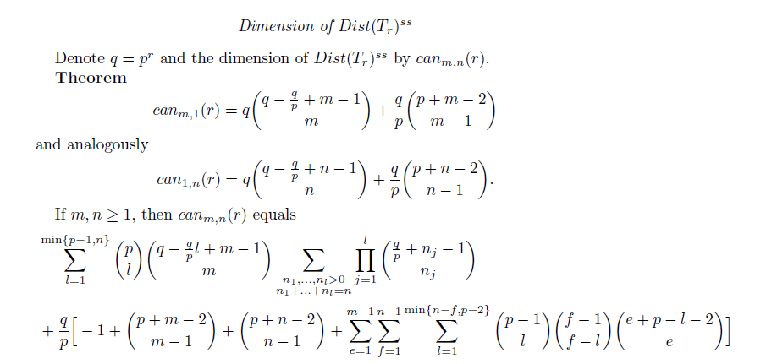

Slide 9
Thanks for your attention!

