Slide 1
Linkage principle for general linear and orthosymplectic supergroups
Maurice Auslander International Conference
April 28, 2016, Woods Hole
Frantisek Marko Alexandr N. Zubkov
Pennsylvania State University Sobolev Institute of Mathematics
Hazleton, USA SORAN, Omsk, Russia

Slide 2
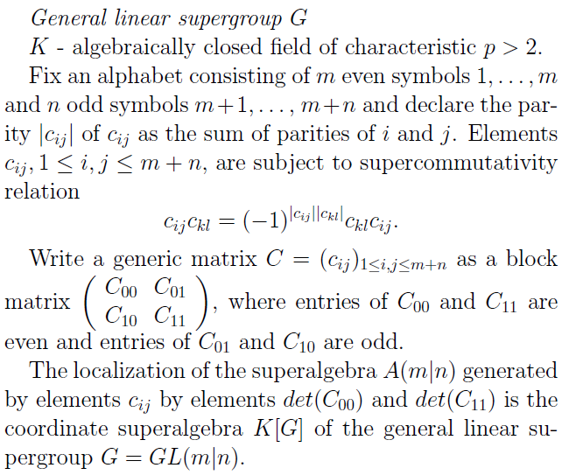

Slide 3
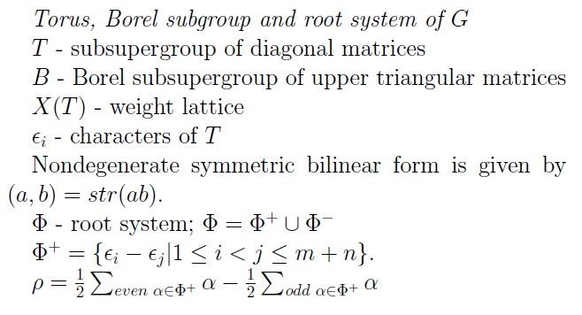

Slide 4
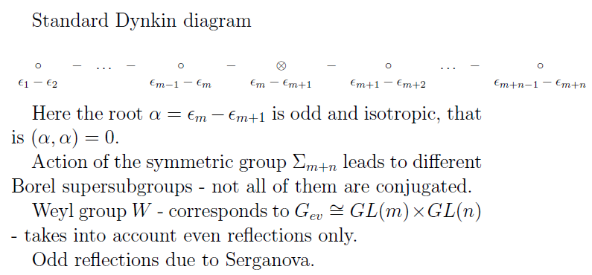

Slide 5
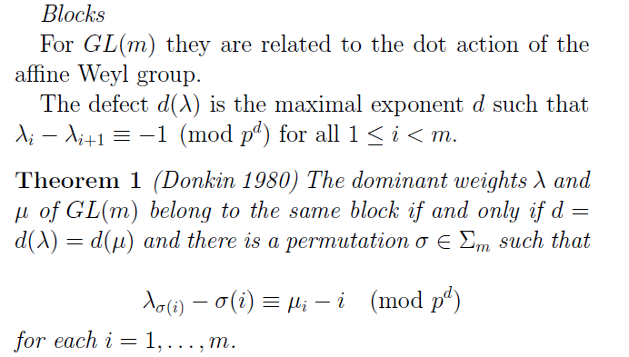

Slide 6
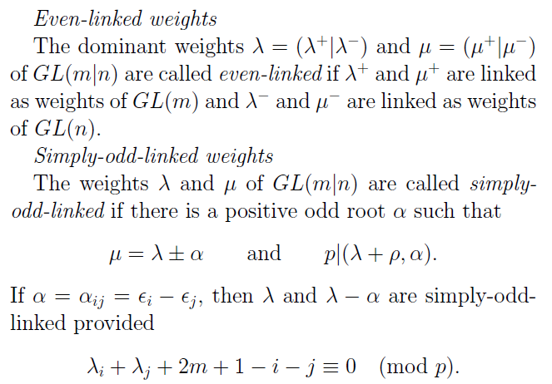

Slide 8
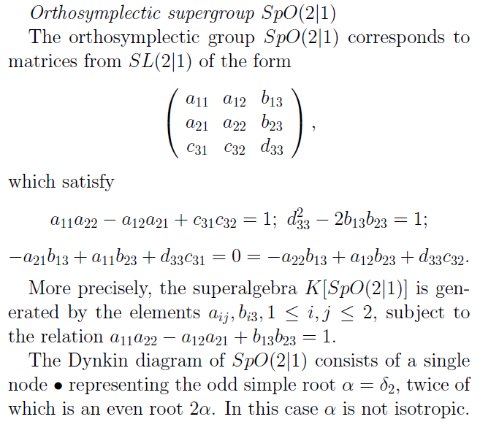

Slide 9
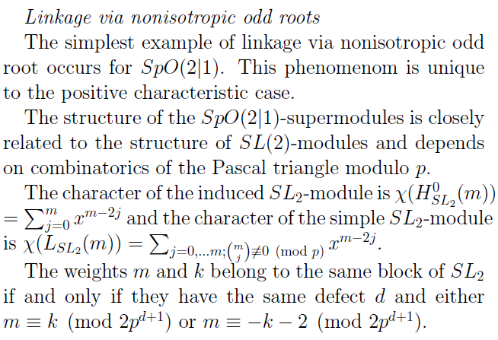

Slide 10
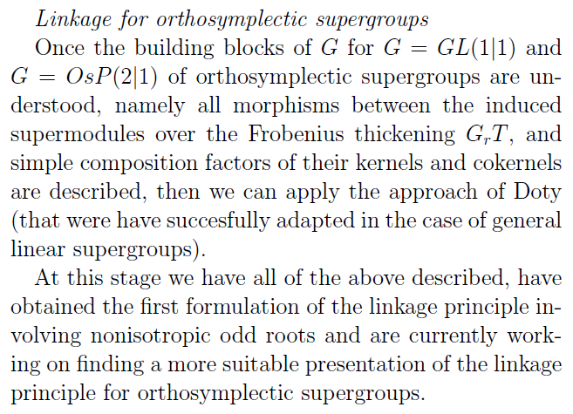

Slide 11
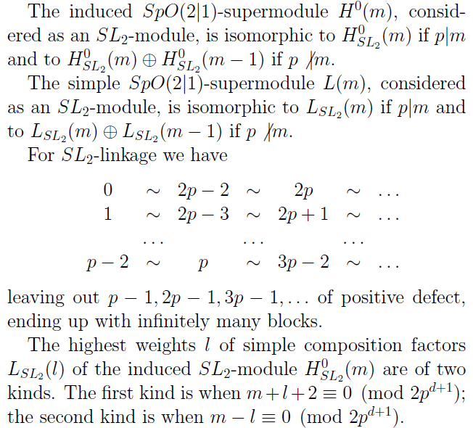

Slide 12
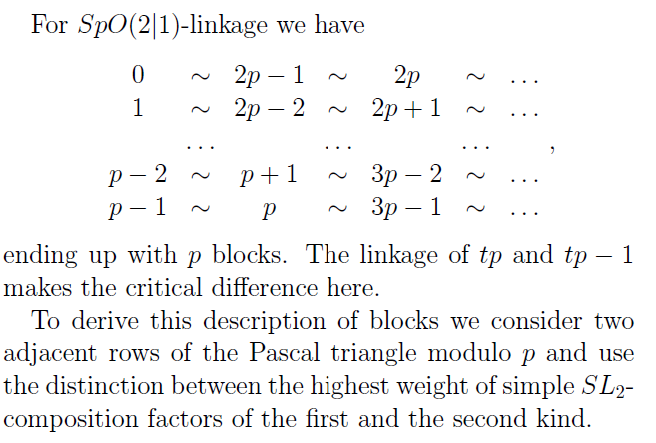

Slide 13
Thanks for your attention!

